Slide 1
A bee sting is acidic.
At the end of the lesson you will need to say how to stop the pain of a bee sting.

Slide 2
Neutralisation

Slide 3
Neutralisation
LO: State the general word equation for neutralisation.
Acids and alkalis react to form a neutral substance.
acid + alkali → salt + water
Salt can be common salt (sodium chloride) or one of many other salts
All salts have two-part names
Eg. silver bromide, magnesium sulfate

Slide 4
Neutralisation Reactions Lab
LO: State the general word equation for neutralisation.
Measure 10cm³ of sodium hydroxide using a small measuring cylinder.
Pour the sodium hydroxide into a beaker.
Add a few drops of universal indicator to the beaker.
Measure 20cm³ of hydrochloric acid using a large measuring cylinder.
Using a pipette add the hydrochloric acid to the beaker one drop at a time.
Count how many drops you add to neutralize the mixture.

Slide 5
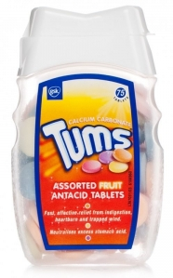
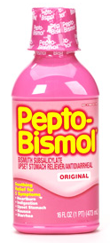
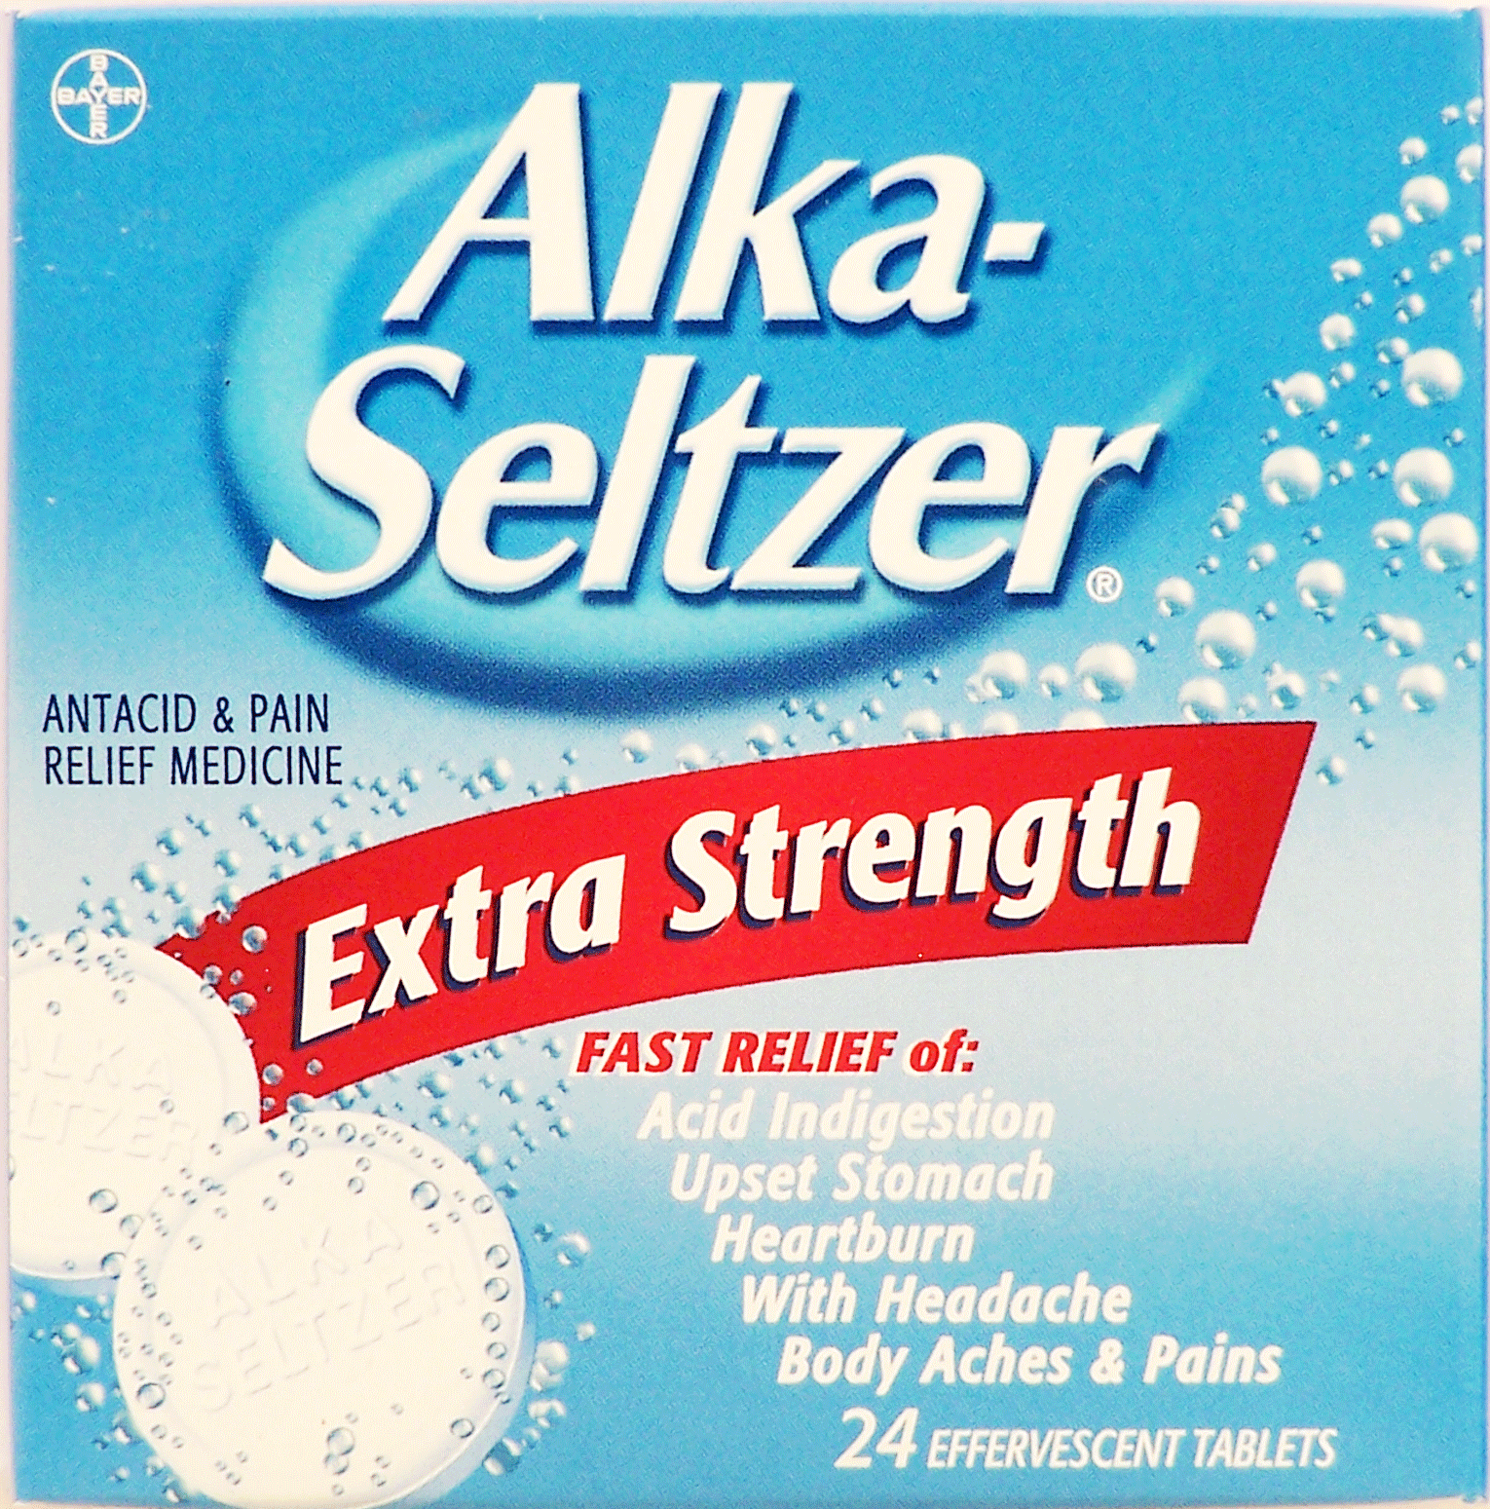
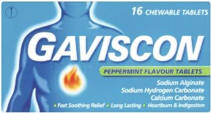
Useful Neutralisations
LO: Describe some examples of useful neutralisation reactions.
Indigestion Medications
Contain carbonates (alkali) which neutralize stomach acid

Slide 6
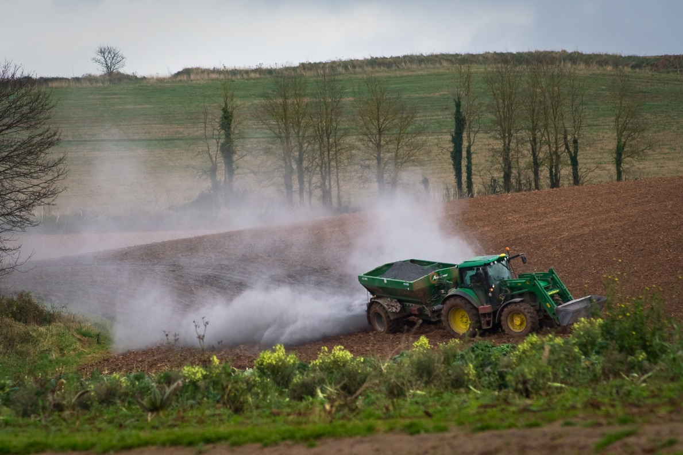
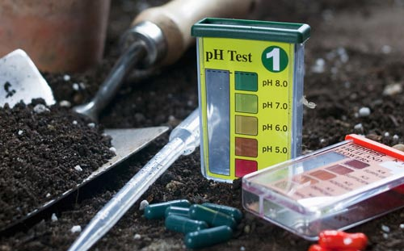
Useful Neutralisations
LO: Describe some examples of useful neutralisation reactions.
Farming and Gardening
Add alkalis to acidic soil
Encourages plant growth because more nutrients are available to the plants

Slide 7
Dear Gardening World, I have very alkaline soil plus my water is alkaline too with a lot of minerals in it. My problem is that, with the alkalinity, some of my plants get iron deficiency.. Does anyone have any idea what I can add to my soil so that it is healthy enough to overcome this problem?
Dear Gardening World, I would like to grow some beautiful Lilacs. The packet says they like alkaline soil. I’ve tested the pH of the soil in my garden and its pH5. Is there anything I can do?
Dear Gardening World, My grass blades are turning yellow between the veins, but the veins themselves are remaining green. Someone told me this was because of Iron deficiency. I have read that Iron deficiency can be caused by acidic conditions. Help I don’t know what to do about it!
Hand-in your response for 5 marks.

Slide 8
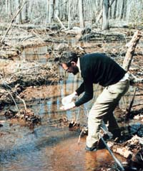
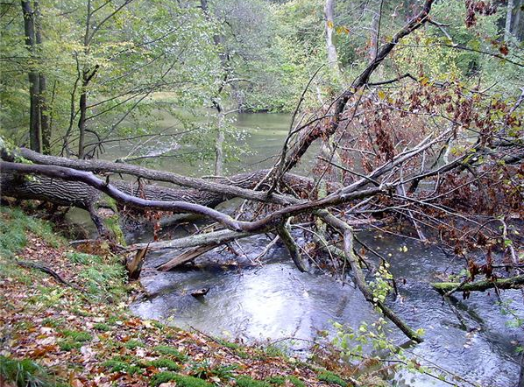
Useful Neutralisations
LO: Describe some examples of useful neutralisation reactions.
Acid Rain Remediation
Neutralize lakes that have been affected by acid rain
In these lakes animal and plant life is killed by the acidic conditions

Slide 9
A bee sting is acidic.
How would you stop the pain of a bee sting?
Show Miss Neubauer your answer to finish the lesson.

