Slide 1
What is happening to the particles?
How do you know a reaction has occurred?
Demonstration
http://www.youtube.com/watch?v=DITY2rXYU-I
Notes:
Start with KI, add Pb (NO3)2

Slide 2
How do we know a chemical
reaction has taken place?
What happens to the mass in a reaction? Why?

Slide 3
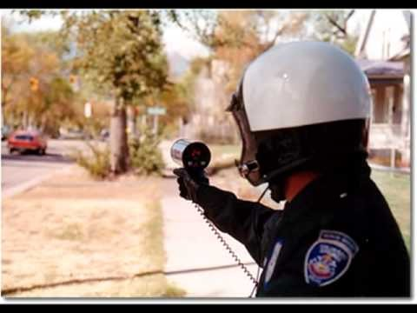
How do we know a chemical
reaction has taken place?
What happens to the mass in a reaction? Why?
http://www.youtube.com/watch?v=QjVYz00-Kxc

Slide 4
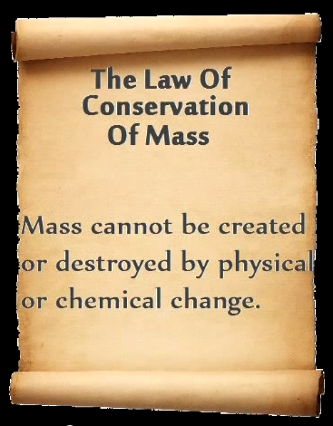

Slide 5
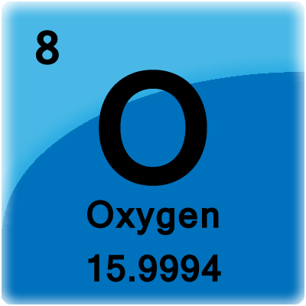
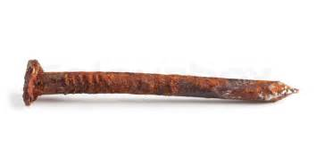
What happens to the mass in each reaction?
+
→
10.0 g
14.3 g
Solid + Gas → Heavier Solid

Slide 6
Lab
Salt and Water
Bicarbonate Soda and Acetic Acid
What happens to the mass in each reaction?

Slide 7
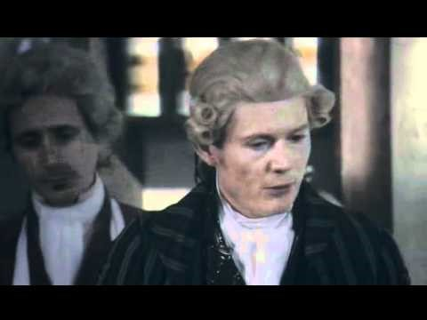

Slide 8
Review Your Learning
In pairs, make up a mime which explains what you have learnt this lesson.
http://www.youtube.com/watch?v=x9iZq3ZxbO8&feature=related

Slide 9
States of Matter
Solid
Liquid
Aqueous
Gas
(s)
(l)
(aq)
(g)
Iron Fe_{(s)}
Mercury Hg_{(l)}
Water H₂O_{(aq)}
Oxygen O_{2(g)}

